Slide 1

Efficiency Unleashed: Reimagining A-to-B Paths in Graphs
Edas no: 1570961547
Sutejas K – sutejaskpes@gmail.com – PES University
K S Ramalakshmi – rlsri2305@gmail.com – PES University
Srinivas K S – srinivasks@pes.edu – PES University

Slide 2
Outline
Motivation
Related works
Proposed Method
Results
Summary
Future Work
References

Slide 3
Motivation
Need to address algorithms and techniques that can identify shortest paths in graphs
Current approaches lack identification of redundant points, generalization, and parallelization
This compromises the speed, space efficiency, and accuracy of the results obtained

Slide 4
Background information
Previous implementations lacked
Identification of redundant points
Generalization
Parallelization,
compromising the speed, space efficiency, and accuracy of the results delivered.
Techniques were designed for integer graphs without generalization
These limitations underscore the need for novel algorithmic enhancements and parallelization techniques to address the computational demands of modern applications.

Slide 5
Proposed Methods
The Concept of Parallelization
Parallelization is a type of computation in which many calculations or processes are carried out simultaneously.
This concept is applied to the algorithms for finding shortest paths to give improved results.

Slide 6
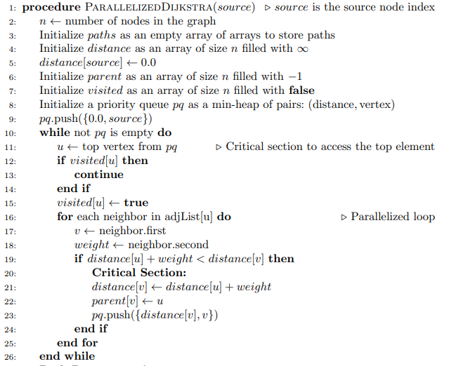



Proposed Methods
Parallelized Dijkstra’s Algorithm

Slide 7
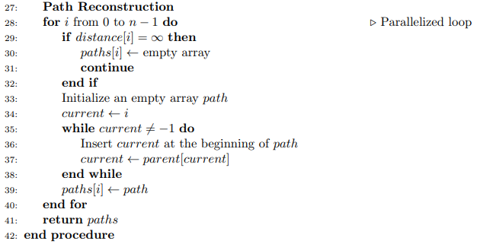
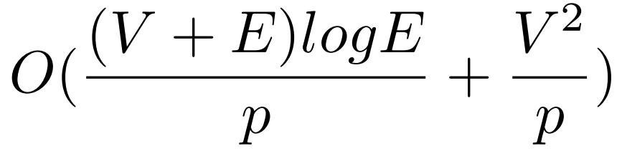

Proposed Methods
Parallelized Dijkstra’s Algorithm
Time Complexity :

Slide 8
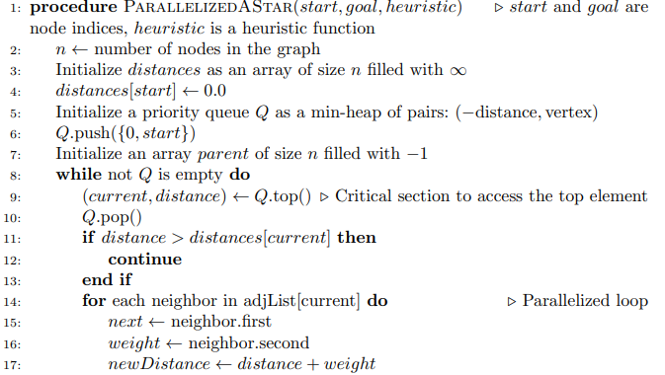


Proposed Methods
Parallelized A* Heuristic Search

Slide 9
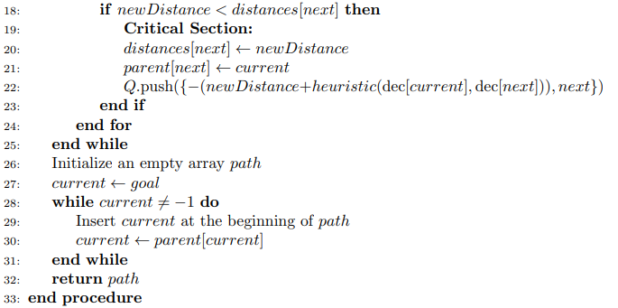
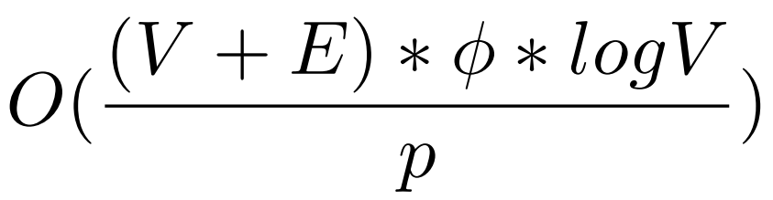
Proposed Methods
Parallelized A* Heuristic Search
Time Complexity:

Slide 10
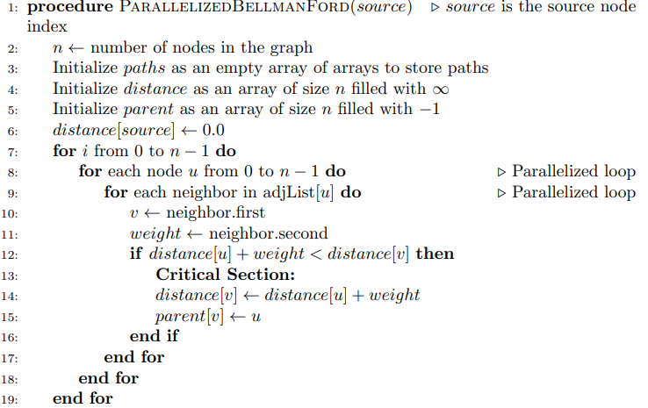


Proposed Methods
Parallelized Bellman Ford Algorithm

Slide 11
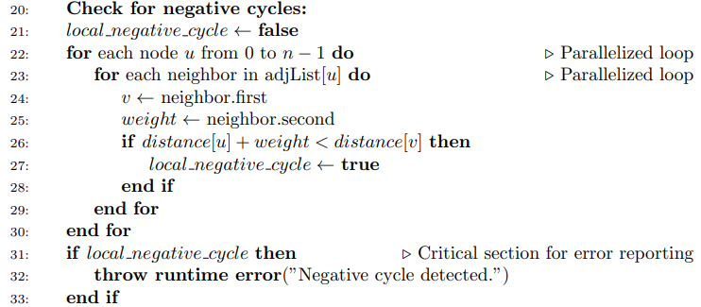


Proposed Methods
Parallelized Bellman Ford Algorithm

Slide 12

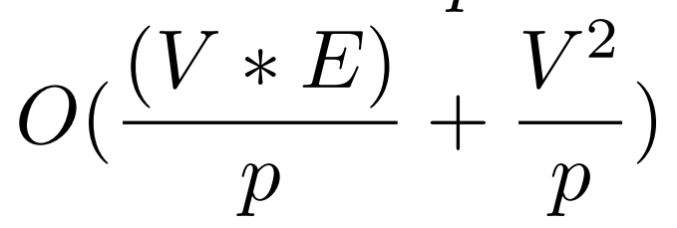

Proposed Methods
Parallelized Bellman Ford Algorithm
Time Complexity:

Slide 13
Results
Dataset used for experimentation
New York City benchmark graph dataset consisting of directed graphs
Node counts: from 108 to 4882
Edge counts: from 290 to 14110

Slide 14
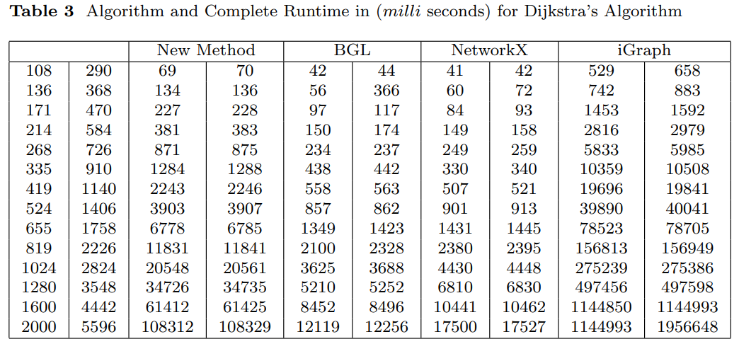
Results
Parallelized Dijkstra’s Algorithm

Slide 15
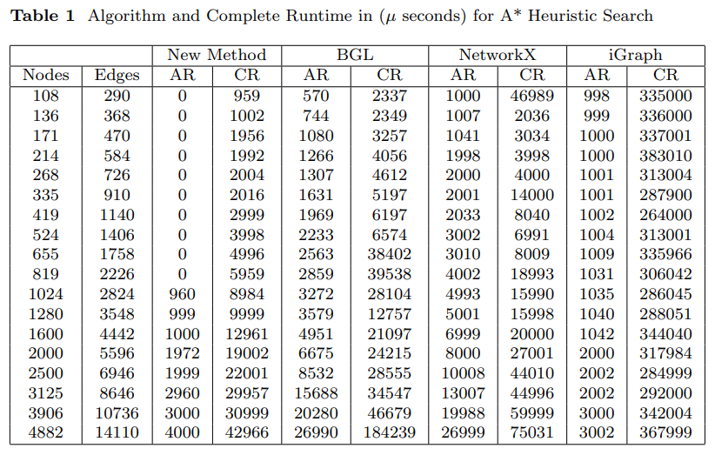
Results
Parallelized A* Heuristic Search

Slide 16
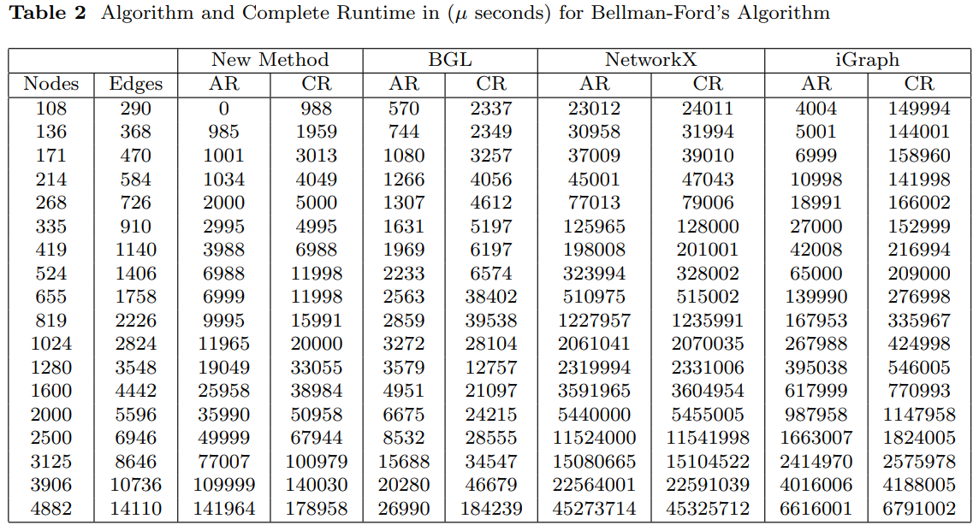
Results
Parallelized Bellman Ford Algorithm

Slide 17
Summary
Research Focus on 2 key enhancements
Utilizing hashmap encoding
Implementing parallelization
Optimizing graph theory algorithms, particularly shortest path search – helps in routing and resource management
Reduced computational complexity
Enhanced practicality

Slide 18
Future Work
Extending implementation to other algorithms
Johnson’s Algorithm, etc.
Parallelizing other graph algorithms
Minimum Spanning Tree
Centrality Measures

Slide 19
References
[1] Fan, D., Shi, P.: Improvement of dijkstra’s algorithm and its application in route planning. In: 2010 Seventh International Conference on Fuzzy Systems and Knowledge Discovery, vol. 4, pp. 1901–1904 (2010). IEEE
[2] Huang, Y.: Research on the improvement of dijkstra algorithm in the shortest path calculation. In: 2017 4th International Conference on Machinery, Materials and Computer (MACMC 2017), pp. 745–749 (2018). Atlantis Press
[3] Xie, D., Zhu, H., Yan, L., Yuan, S., Zhang, J.: An improved dijkstra algorithm in gis application. In: World Automation Congress 2012, pp. 167–169 (2012). IEEE
[4] Zhu, Z., Li, L., Wu, W., Jiao, Y.: Application of improved dijkstra algorithm in intelligent ship path planning. In: 2021 33rd Chinese Control and Decision Conference (CCDC), pp. 4926–4931 (2021). IEEE
[5] Ju, C., Luo, Q., Yan, X.: Path planning using an improved a-star algorithm. In: 2020 11th International Conference on Prognostics and System Health Management (PHM-2020 Jinan), pp. 23–26 (2020). IEEE

Slide 20
References
[6] Yao, J., Lin, C., Xie, X., Wang, A.J., Hung, C.-C.: Path planning for virtual human motion using improved a* star algorithm. In: 2010 Seventh International Conference on Information Technology: New Generations, pp. 1154–1158 (2010). IEEE
[7] Hong, Z., Sun, P., Tong, X., Pan, H., Zhou, R., Zhang, Y., Han, Y., Wang, J., Yang, S., Xu, L.: Improved a-star algorithm for long-distance off-road path planning using terrain data map. ISPRS International Journal of Geo-Information 10(11), 785 (2021)
[8] Zheng, T., Xu, Y., Zheng, D.: Agv path planning based on improved a-star algorithm. In: 2019 IEEE 3rd Advanced Information Management, Communicates, Electronic and Automation Control Conference (IMCEC), pp. 1534–1538 (2019). IEEE
[9] Busato, F., Bombieri, N.: An efficient implementation of the bellman-ford algorithm for kepler gpu architectures. IEEE Transactions on Parallel and Distributed Systems 27(8), 2222–2233 (2015)

